Slide 1

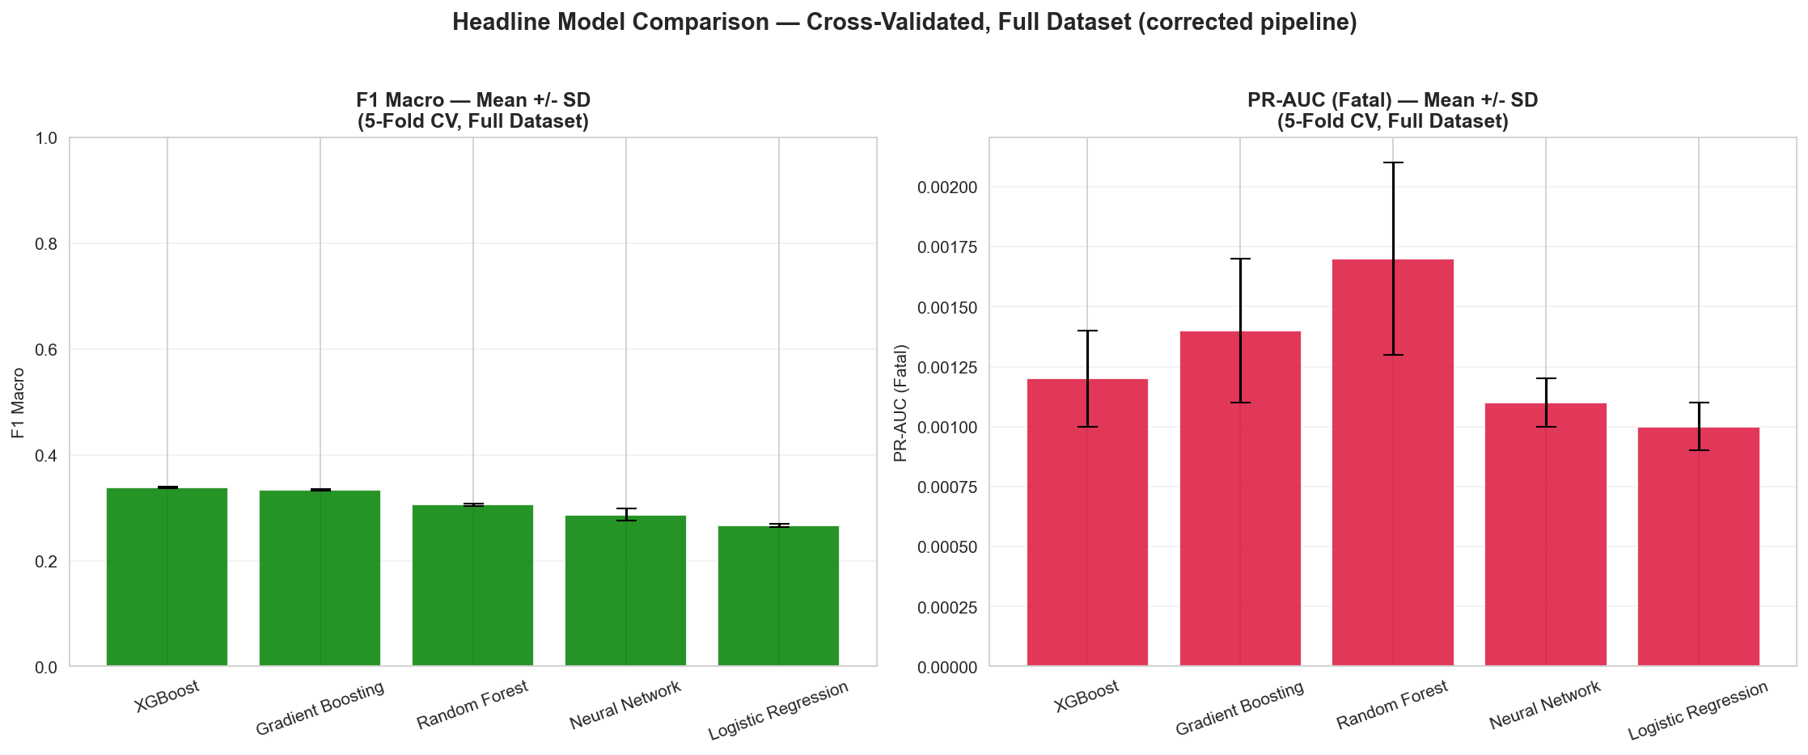
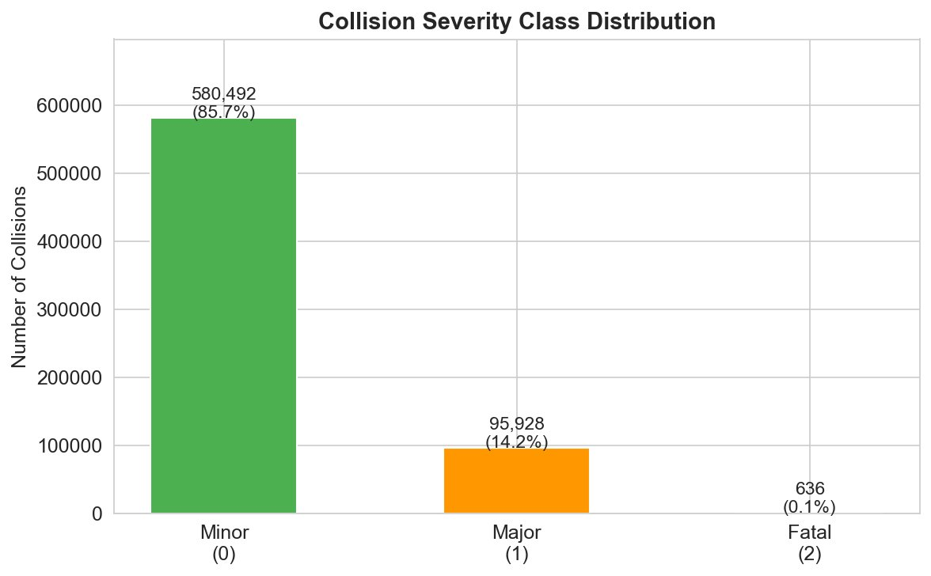
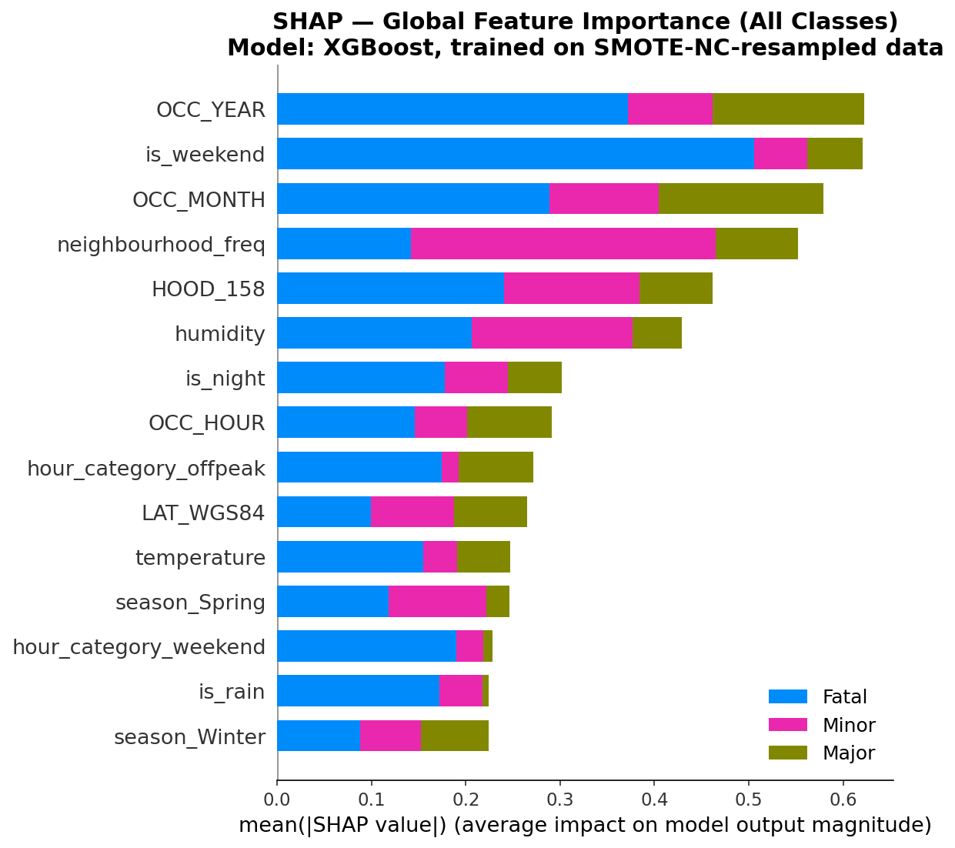
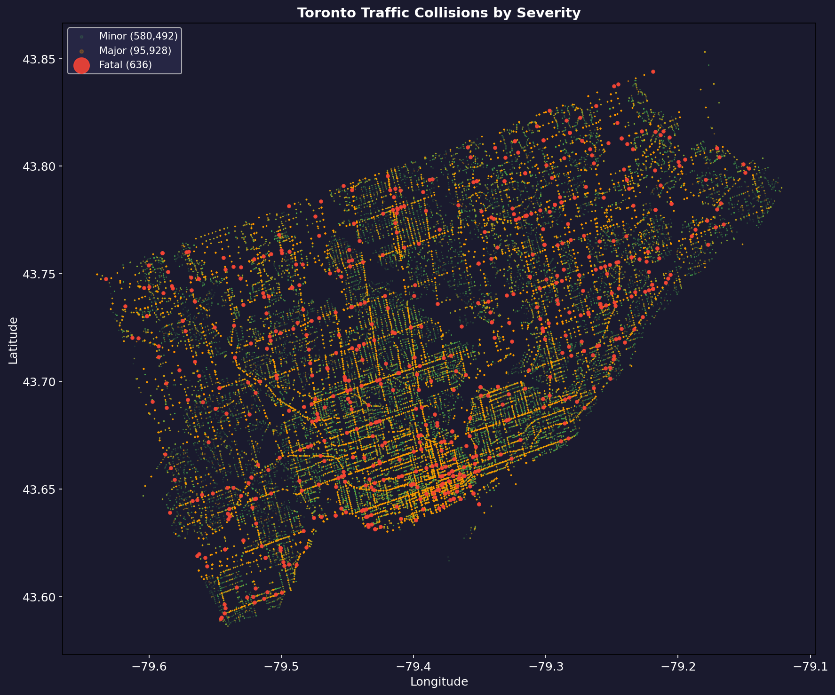
2025-2026 M.Sc. in Data Science and Analytics
Predicting and Explaining Traffic Collision Severity in Toronto
Using Explainable Machine Learning
Nishi Bhavesh Patel | Student ID: 501356244
Supervisor: Professor Mucahit Cevik
Objective
Traffic collisions remain a critical public-safety concern in Toronto, causing hundreds of fatalities and thousands of injuries every year, yet most existing analyses only describe past patterns instead of predicting risk. This project builds an explainable machine-learning pipeline that predicts collision severity - Minor (property damage only), Major (one or more injuries), or Fatal (one or more fatalities) - using 677,056 cleaned Toronto collision records (2014–2026) merged with hourly Government of Canada weather data (Station 31688). Five classifiers are trained and compared, five class-balancing strategies address the severe imbalance (Fatal collisions are only 0.1% of records), and SHAP explainability plus DBSCAN geospatial clustering are used to interpret model behaviour and descriptively identify spatial concentrations of Fatal collisions that may support further road-safety investigation. The goal is not just accuracy: a model that is both accurate and interpretable can tell the City of Toronto not only which collisions are likely to be severe, but why - and where further investigation may be warranted. Every result below (data, models, explanations, and the map of hotspot zones) is built to answer that question.
Background
Results
Why this matters: Because Minor crashes vastly outnumber Fatal ones, a model that just guesses “Minor” every time looks 86% accurate while missing every life-threatening case - exactly the cases road-safety planners most need flagged. Data sources: City of Toronto collision records merged, date-hour by date-hour, with Government of Canada hourly weather (temperature, humidity, precipitation) from Station 31688. Invalid GPS records were removed and temporal, weather, and neighbourhood-based features were engineered. Outcome-correlated involvement indicators (pedestrian, cyclist, passenger, motorcycle) identified during the leakage audit were excluded from the final predictive feature set. Severity class distribution (n = 677,056):
Model Performance — 5-Fold Cross-Validation Full dataset (677,056 records) • Corrected pipeline • Five models
The central finding: correcting involvement-flag leakage and a SMOTE-NC encoding error substantially reduced apparent performance from an inflated 0.784 ROC-AUC. Under the corrected, leakage-free, correctly-encoded setup, all five model families show Fatal-class PR-AUC of 0.0010–0.0017, close in absolute terms to a 0.0009 prevalence reference - supporting limited Fatal-class separability under the current predictors and modelling setup, while not ruling out gains from richer predictors or other approaches. XGBoost leads F1 Macro (0.338) and accuracy (81.4%); Random Forest leads Fatal-class PR-AUC (0.0017): neither is an outright winner, and XGBoost still identifies 0 of 95 real Fatal collisions on the validation split.
Balancing and tuning don't fix this either: four of five strategies achieve 0% Fatal recall; only random undersampling recovers meaningful recall (41.1%), at the cost of accuracy collapsing to 37.3%. Lowering the threshold to 0.05 raises Fatal recall to 58.95%, but costs 38.5 accuracy points and precision falls to 0.11% - this study makes no deployment recommendation.
SHAP feature importance (left) and DBSCAN Fatal-collision map (right):
Figure 1. Severity class distribution - Minor 85.7%, Major 14.2%, Fatal 0.1%.
Methodology
Split: 70% train / 15% validation / 15% test, stratified by severity. Headline performance comes from full-dataset 5-fold CV; the test set is used only for SHAP. Balancing: Five strategies were compared on the validation split — SMOTE-NC, ADASYN, SMOTETomek, no resampling, and random undersampling. For the headline 5-fold CV, SMOTE-NC was applied only within each training fold to prevent resampling leakage. Models: Logistic Regression, Random Forest, Gradient Boosting, XGBoost, and a Neural Network, each evaluated with 5-fold stratified cross-validation. Tuning: RandomizedSearchCV hyperparameter search on the strongest model, plus decision-threshold tuning to trade precision for Fatal recall. Explainability: SHAP TreeExplainer was applied to the final XGBoost model using a sample from the held-out test set to examine global feature importance and individual predictions. Geospatial: DBSCAN clustering (density-based, no need to pre-set a number of clusters) groups the 636 fatal-collision coordinates into 36 dense hotspot zones across the city. Tools: Python, scikit-learn, XGBoost, imbalanced-learn, SHAP, and DBSCAN - the full pipeline runs from raw CSVs to final explanations reproducibly, notebook by notebook.
is_weekend, OCC_YEAR, OCC_MONTH, neighbourhood frequency, and location lead the SHAP ranking - model behaviour, not validated risk factors, given the near-null Fatal PR-AUC. DBSCAN (eps = 300 m) identifies 36 Fatal-collision hotspot clusters (large red dots), but 499 of 636 Fatal collisions (78.5%) are spatially isolated noise points, not part of any cluster - a descriptive spatial layer, not a comprehensive risk map.
Conclusions
• After correcting involvement-flag leakage and the SMOTE-NC encoding error, Fatal-class discrimination decreased substantially (PR-AUC 0.0010–0.0017, close in absolute terms to the approximate Fatal-prevalence reference level of 0.0009). The corrected results indicate the earlier strong-looking performance (0.784 ROC-AUC) was substantially inflated by these methodological issues. • XGBoost leads on F1 Macro (0.338) and accuracy (81.4%); Random Forest leads on Fatal-class PR-AUC (0.0017) - neither is an outright winner, and even XGBoost still identifies 0 of 95 real Fatal collisions on the validation split. • Balancing and threshold tuning do not resolve this: only aggressive undersampling recovers meaningful Fatal recall, and only by sacrificing most of the model's accuracy; hyperparameter tuning can actively hurt Fatal-class detection. • DBSCAN clustering — unaffected by the leakage and encoding issues above — provides a complementary descriptive spatial analysis: 36 Fatal-collision hotspot clusters were identified across Toronto, including areas around Wexford/Maryvale, West Humber-Clairville, and South Parkdale, while most Fatal collisions remain spatially unclustered (noise).
Limitations:
Fatal collisions remain extremely rare (636 records); a single weather station limits hyperlocal precision; invalid-GPS rate differs by class (16.91% Minor, 12.56% Major, 4.50% Fatal); and the headline CV is not a strictly independent, nested estimate relative to the validation-split selection decisions.
1
Merge Collisions
+ Weather
→
2
Clean Data +
Engineer Features
→
3
Split + Balance
(5 strategies)
→
4
Train & Tune
5 Models
→
5
SHAP + DBSCAN
Explain Results
KEY NUMBERS
Five-Phase Research Pipeline
0.338
XGBoost - F1 Macro
0.0017
Random Forest - Fatal PR-AUC
0 / 95
XGBoost Fatal Recall
36
DBSCAN Hotspot Zones

